Slide 1
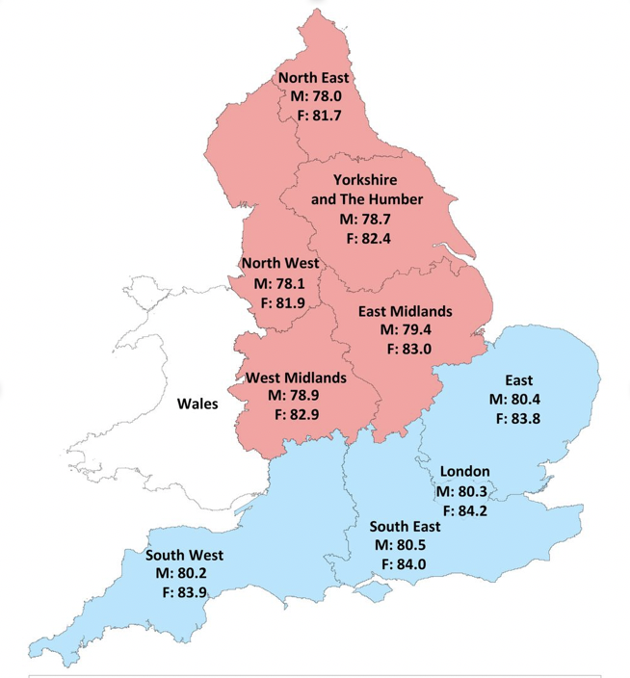
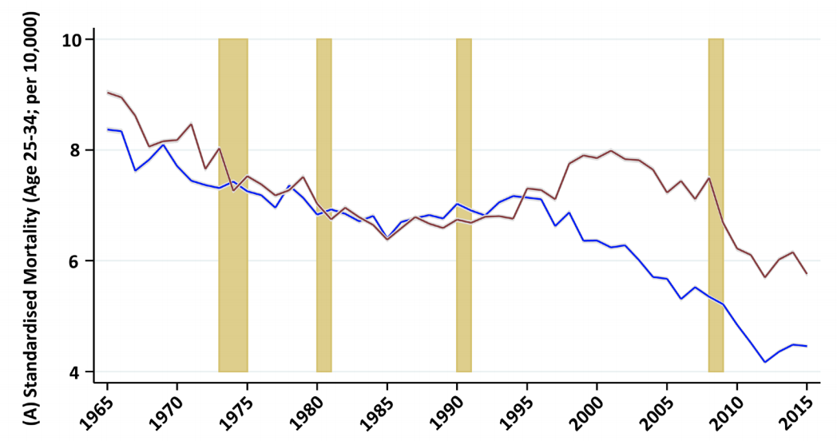
NORTH-SOUTH DISPARITIES IN ENGLISH MORTALITY
(Kontopantelis E, Buchan I, Webb RT, Ashcroft DM, Mamas MA, Doran T. Disparities in mortality among 25–44-year-olds in England: a longitudinal, population-based study. Lancet Public Health. 2018; doi:10.1016/S2468-2667(18)30177-4)
BACKGROUND
FINDINGS
IMPLICATIONS
England has profound and persistent geographical divides in economy, society and health, with major disparities between northern and southern regions.
For most ages, northern excess mortality remained consistent between 1965 and 2016, but for ages 25-44 northern excess mortality increased sharply from 1995, mainly due to alcohol and drug misuse.
Under 75 mortality rates have been consistently higher in northern compared with southern regions of England.
Mortality rates diverged alarmingly for those aged 25-44 in the mid 1990s, largely due to alcohol and drug misuse.
These widening divisions suggest increasing psychological distress and risk-taking among young and middle-aged adults, particularly outside of London.
Effective policy responses may require substantial social and economic changes, including a rebalancing of the economy between the North and South of England proportionate to the scale of the problem.
Life expectancy
Mortality rates in London were substantially lower than in all other regions, both north and south. Excess mortality compared to London ranged from 13% for East England to 22% for the North East.
We examined long-term trends in mortality in northern versus southern regions in England across age groups and the underlying causes of excess mortality.
Full text: https://bit.ly/2YjBHmJ
Notes:
Kontopantelis E, Buchan I, Webb RT, Ashcroft DM, Mamas MA, Doran T. Disparities in mortality among 25–44-year-olds in England: a longitudinal, population-based study. Lancet Public Health. 2018; doi:10.1016/S2468-2667(18)30177-4

